Slide 1
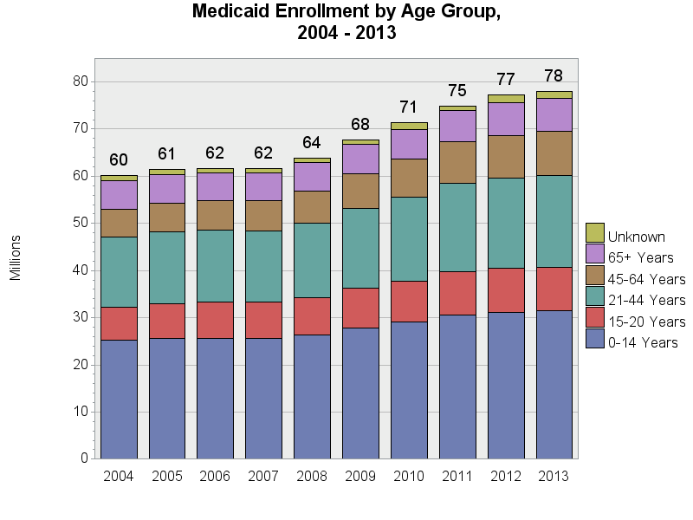
SOURCE: Chronic Condition Data Warehouse (CCW). MAX Person Summary Files.
Notes:
Description: Children (0 - 14 years) and adolescents (15 - 20 years) comprise the plurality Medicaid enrollees. The number of enrollees has increased over time in each of the age groups. The proportion of enrollees by age group has been fairly stable over time, with slightly fewer 0-14 year olds (41.8% in 2004 and 40.3% in 2013) and 65+ year enrollees (9.9% in 2004 and 9.0% in 2013), but more 45-64 year olds (9.7% in 2004 and 12.0% in 2013).
Technical notes: Age is calculated based on age at the end of the calendar year.

