Slide 1
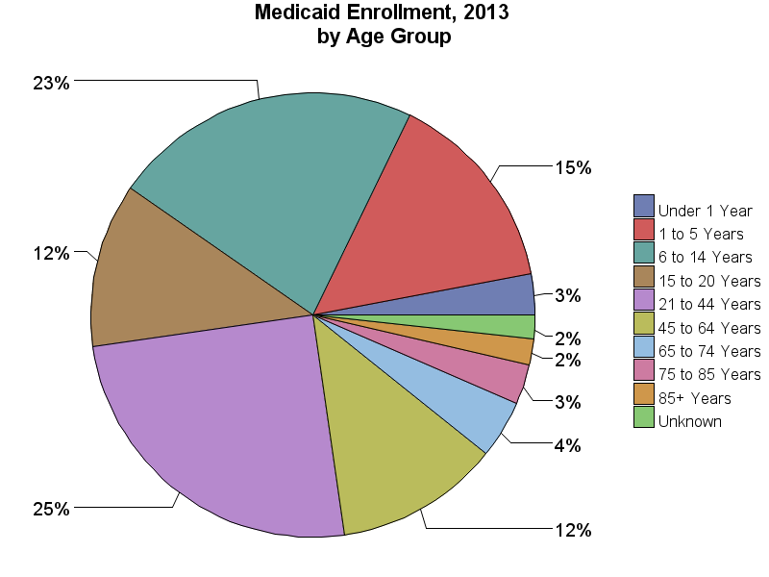
SOURCE: Chronic Condition Data Warehouse (CCW). MAX Person Summary Files.
Notes:
Description: Children (0 - 14 years) and adolescents (15 - 20 years) comprise the majority of Medicaid enrollees (52.3% of total enrollees). Adults from the 21-44 year and 45-64 year age groups comprise 36.9% of all enrollees. 65+ year enrollees comprise 9.0% of Medicaid enrollees in 2013.
Technical notes: Age is calculated based on age at the end of the calendar year.

