Slide 1
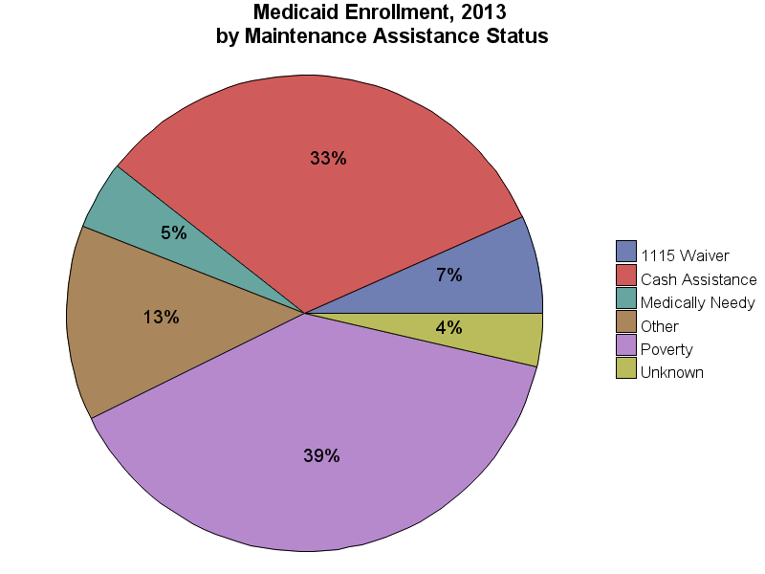
SOURCE: Chronic Condition Data Warehouse (CCW). MAX Person Summary Files.
Notes:
Description: The proportion of the Medicaid population eligible due to either Poverty or Cash Assistance in 2013 was 71.8%. A total of 4.6% of the Medicaid population was eligible due to being classified as Medically Needy.
Technical notes: Maintenance Assistance Status – determined using the first digit of the uniform eligibility code.

