Slide 1
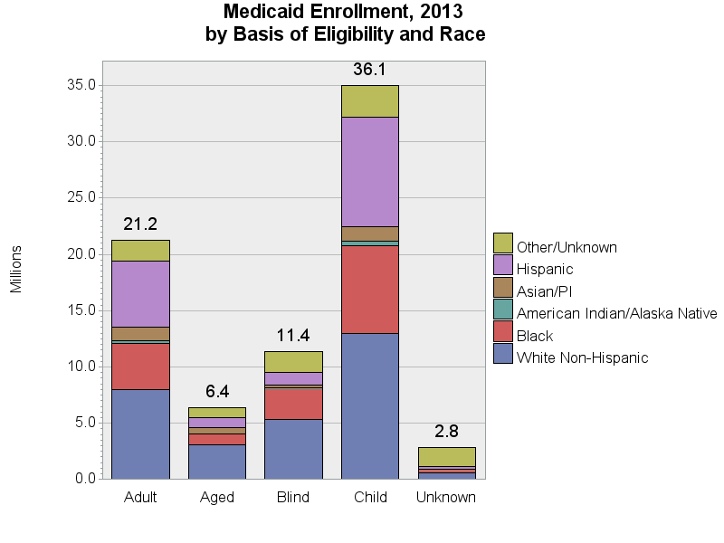
SOURCE: Chronic Condition Data Warehouse (CCW). MAX Person Summary Files.
Notes:
Description: White Non-Hispanics comprise the largest category within each of the Eligibility groups. Blacks comprise the second largest racial group for Aged and Blind categories, and Hispanics comprise the second largest racial group for Adult and Child.
Technical notes: Basis of Eligibility – determined using the second digit of the uniform eligibility code. The “Blind” category includes blind/disabled. Some race categories were combined due to small numbers: the Asian and Pacific Islander groups are combined; the More than one race categories and unknown race are included in the “Other/Unknown” group.

