Slide 1
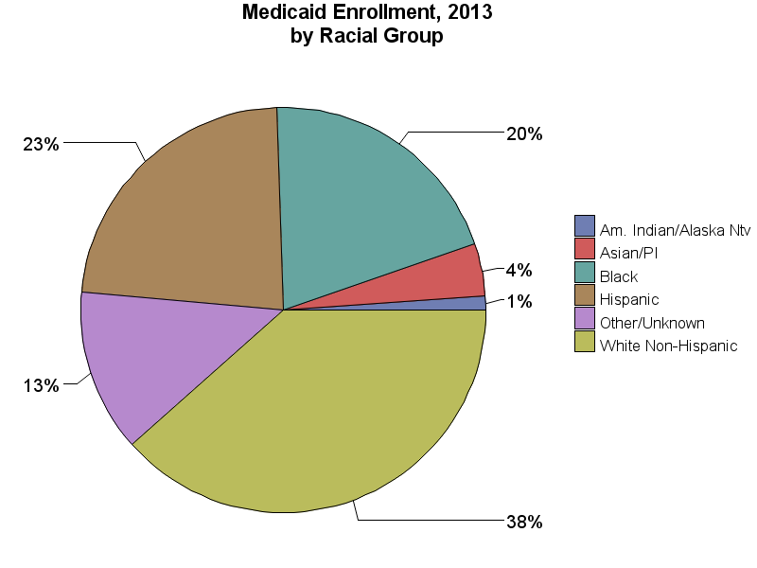
SOURCE: Chronic Condition Data Warehouse (CCW). MAX Person Summary Files.
Notes:
Description: The White Non-Hispanic racial group is the largest racial category (38.4% of enrollees), followed by Hispanic (23.0%) and Black (20.2%). 4.2% of enrollees in 2013 were Asian or Pacific Islander, 1.1% were American Indian or Alaska Native, and 13.0% were more than one race, another race, or unknown racial category.
Technical notes: Race classification changed in 2000 to allow for selection of more than one race. For this graphic, some race categories were combined due to small numbers: the Asian and Pacific Islander groups are combined; Hispanic and Hispanic More than One Race are combined; the More than one race categories and unknown race are included in the “Other/Unknown” group.

