Slide 1
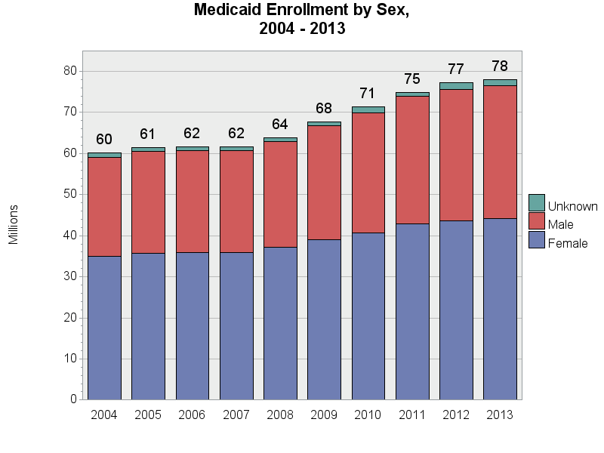
SOURCE: Chronic Condition Data Warehouse (CCW). MAX Person Summary Files.
Notes:
Description: The distribution of Medicaid enrollees by sex has been very stable over time, with approximately 56.7-58.3% of enrollees classified as female.

